Slide 1
Police Bot: Enhancing Social Media Governance with Policing Bots
Milestone 3 Presentation

Slide 2
Group Members:
Students:
Gabriel Silva
Cody Manning
Liam Dumbell
Faculty Advisor / Project Client:
Khaled Slhoub
Computer Science Project Instructor:
Philip Chan

Slide 3
Overview:
Discussion of Task Completion:
Decision on a single starting bot detection method.
Development on implementation of chosen bot detection method.
Data Collection System Improvements.
Demo of rote bot detection method implementation.
Demo of Database System.
Faculty Advisor / Project Client Feedback
Technical Challenges Update
Plans heading towards Milestone 4

Slide 4
Task Completion
Decision on a single starting bot detection method.
Academic papers provided by Client reviewed by each team member.
Reddit Comment Text Frequency Analysis deemed most prudent for a starting bot detection method.
Implemented using Python Spacy library.
More bot detection methods needed in the future to ensure reliable degree of accuracy.

Slide 5
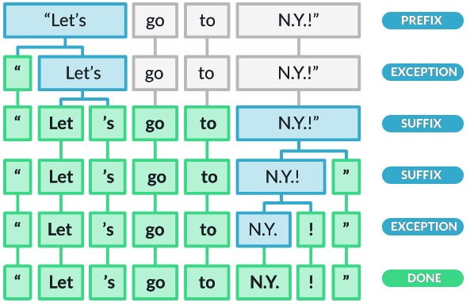
Task Completion
Development on implementation of chosen bot detection method.
Bot Detection through Text Frequency Analysis in development and a working version has been created.
Functional Bot Detection is currently in the prototype stage.
Development towards Reliable Bot Detection is still ongoing.

Slide 6
Task Completion
Data Collection System Improvements
CSV data storage solution modified to include headers.
bot_db mysql Database created to store all data retrieved by the framework.
Python script created that automatically reads all CSV data and organizes them into relevant tables.
bot_db is currently being hosted locally, but the functionality to switch to AWS has been added.
The switch to AWS will be made when local data storage becomes insufficient

Slide 7
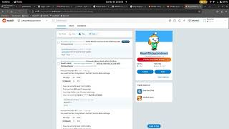
Bot Detection Progress Demo
https://www.youtube.com/watch?v=D79GxjfcuUY

Slide 8
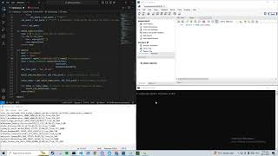
Database System Demo
https://www.youtube.com/watch?v=uzvaqaAlBp4

Slide 9

Faculty Advisor / Project Client Feedback
Text Frequency Analysis was agreed to be a good starting bot detection method for our project.
The need for additional bot detection methods that address our current system’s weaknesses was discussed.
Setting a meeting with one of our client’s PHD student was discussed and is set to take place before the end of semester to discuss working on porting our framework back to Twitter (in addition to Reddit).

Slide 10
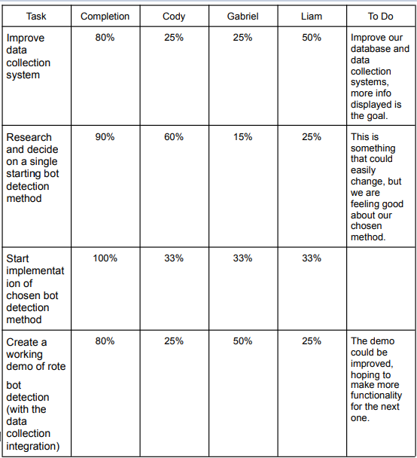
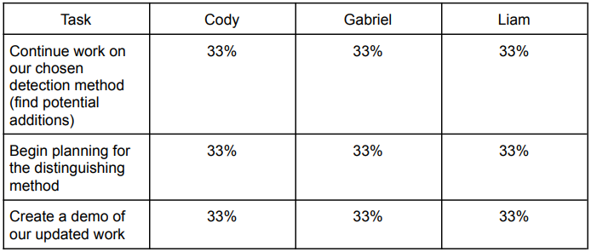
Milestone 3
Milestone 4

Slide 11
Technical Challenges Update
Progress on Resolving Challenges
Expanded skills using the Reddit API.
Expanded experience with using / creating Reddit Bots.
Expanded HTML Knowledge.
Expanded Knowledge on Bot Detection Methods and Implementations.
Technical Challenges that require attention going forward
Deepen understanding on the math behind text frequency analysis.
Start in-depth research in other bot detection methods.
Start research on Bot Distinguishing Methods and Implementations

Slide 12
Moving Towards Milestone 4:
Continue work on implementing Bot Detection through Text Frequency Analysis.
Identify and Incorporate additional bot detection algorithms to improve accuracy of predictions.
Update database with any new fields from bot detection development
Start research and development on Bot Distinguishing System.
Create Bot Distinguishing Prototype.
Create Demos of improved Bot Detection System and prototype Bot Distinguishing System.

Slide 13
This concludes our presentation, Thank You

